Slide 1
Annual General
Meeting
December 18, 2020

Slide 2
Annual General
Meeting Agenda
Welcome/Approve AGM Agenda
Approval of 2019 AGM Minutes
President’s Report
Board of Directors/Approve Slate
Finance Report/Approve Financials
Membership and Communications Committee Report
Professional Development Committee Report
Chapter Update
Toronto
Montreal
2021 Priorities
Other Business
Adjournment

Slide 3
President’s Report

Slide 4
President’s Report
2020 Conference was cancelled!
Spent significant time and dollars before COVID became an issue.
Considerable work already done for next year
Significant uptick in Webinar attendance
Due to great topics and Covid related moves to online
Great Work from the PDC
Last year we increased the number of board positions to 11.
2021 will have the largest number of board members in our history. The momentum is building
Montreal Chapters were active and held multiple events
SLCan continues to maintain a strong financial position
Thanks Mike Dymarski
Membership Committee continues its great work

Slide 5
2021 Board of Directors
Returning Directors
Kevin Belusa
AirGenuity Inc.
Mike Dymarski
Retired, University of Toronto, Fellow of SLCAN
Kevin Humeniuk
Architecture49 Inc.
Jim Delaney
Aqua Air Systems Inc.
John Alberico
RWDI
Yvon Lachance
BGLA Architecture + Design Urbain
Tyler Holmberg
Norlab Laboratory Systems
We would like to thank Erica Brabon & Ian McDermott for their service.

Slide 6
2021 Board of Directors
New Directors
Liam Brown
mcCallumSather
Peggy Theodore
Diamond Schmitt Architects
Steven Corfe
UHN
Vladimir Lazov
WSP

Slide 7
2021 Slate of Officers
President – Yvon Lachance
Finance Director – Mike Dymarski

Slide 8
Hey Yvon, would you like to be president of SLCan in 2021?
Yvon’s response: You’re joking, right?

Slide 9
Yvon: OK, Ok, let me think about it.

Slide 10
Yvon: Yes, I would love to do it. I’m very honoured that you asked.

Slide 11
Voulez-vous bien me dire dans quoi est-ce que je viens de m’embarquer? /
Can you please tell me what I've just gotten myself into?”

Slide 12
Approval of Sustainable Labs Canada Board of Directors Slate
MOTION:
I hereby move that the presented Slate of Directors for Sustainable Labs Canada be approved. Due to webinar AGM this vote will be by Objection.

Slide 13
Committee
Reports
Finance Committee
Membership and Communications Committee (MCC)
Professional Development (PD)

Slide 14
Finance Committee Report
December 18, 2020

Slide 15
Committee Membership
Mike Dymarski - Committee Chair, retired, Norwich ON, Fellow of SLCan
Kevin Belusa – Director of Strategic Sales, AirGenuity, Toronto
Yvon Lachance - ARCHITECTE ASSOCIÉ, BGLA | ARCHITECTURE + DESIGN URBAIN, Montreal QC
Jim Dalaney - Aqua Air Systems Ltd, Edmonton, Alberta

Slide 16
Committee Purpose
The Finance Committee is responsible for the review of revenue and expenses that are associated with administration and operation.
The Committee will provide to the Board a detailed monthly update of the current financial health of the organization and a projection of future liabilities that may be incurred.
Major expenditures are brought to the Board for review and approval.

Slide 17
Committee Activities 2020
Prepared 2020 Budget with Revisions due to Covid-19 impact
Cancellation of National Conference with deposit recovery
8 Monthly Finance Review Meetings were held:
Review of expenses (tighten)
Review of Management support
Look for opportunities to provide alternative services to members
Financials were reviewed by Parker, Prins, Lebano and found to be valid.

Slide 18
Committee Look Ahead 2021
Continue to hold Monthly Committee Meetings
Look for Opportunities to Improve Financial Reporting
Carryout Review of Management Contract with intention of preparing/signing a New Contract
Completion of SOP for Electronic Chequing for future Administration

Slide 19
Finances 2020 as of December 01, 2020
Revenues | 2020 Budget ⁺ | 2020 YTD | 2019
Membership | $ 29,538 | $ 34,413 | $ 41,600
National Conference | $ 0 | $ 0 | $ 179,288
Webinars | $ 500 | $ 720 | $ 120
Total to Date * | $ 30, 037 | $ 35,133 | $ 221,008
Expenses | 2020 Budget ⁺ | 2020 YTD | 2019
Administration | $ 28,500 | $ 26,695 | $ 30,543
National Conference | $ 5,000 | $ 5,432 | $ 181,860
Webinars | $ 5,000 | $ 7,141 | $ 8,004
Website | $ 5,000 | $ 3,040 | $ 5,034
Total to Date * | $ 42,460 | $ 42,308 | $ 225,441

Slide 20
Chapter Finances 2020 as of December 01, 2020
Montreal | 2020 YTD | 2019
Revenue | $ 2,300 | $ 5,125
Expenses | $ 1,332 | $ 2,772
Toronto | 2020 YTD | 2019
Revenue | $ 4,154 | $ 9,911
Expenses | $ 3,343 | $ 7,555

Slide 21
Questions?
MOTION: I move that the 2020 Financial Records and the Financial Report for Sustainable Labs Canada be accepted.

Slide 22
Membership and Communications Committee Report
December 18, 2020

Slide 23
Committee Membership
Yvon Lachance, architect, principal, BGLA Inc. | Architecture + Urban Design (Committee Chair)
Jim Delaney, P. Eng., Aqua Air Systems Ltd., SLCan Board member;
John Alberico, M.Sc., RWDI Inc., SLCan Board member;
Kevin Shelast, P. Eng., Aqua Air Systems Ltd.

Slide 24
Committee Purpose
MCC is responsible for the membership and communication strategies of Sustainable Labs Canada.
The Committee provides advice to the Board with respect to engaging existing and new members while keeping members informed about SLCan activities, membership benefits, and current information related to sustainable laboratories.

Slide 25
Committee Activities 2020
This year, the Committee has not had the time to meet before the pandemic hit;
As of December 3rd, we reached a total number of 161 members in good standing - thanks to all those who have remained loyal to our association in these tough times!;
This is a significant decrease in the number of members compared to last year (215);
So far, 61 people have already renewed for 2021, more than half of them as part of a corporate subscription package;
The Committee set up new categories for members (new information gathered at subscription or renewal time) with the goal to provide them with exposure on the web site trough publication of a list of members.

Slide 26
Committee Look Ahead 2021
New Chair is needed in order to ensure periodic meetings and follow-up (this is a repeat from last year);
More than ever, the Membership Committee is key to the Association’s well being as membership fees are now our main source of income;
A minimum of 160 members is required to help maintain the association’s pertinence and good financial health;
The Committee will need to reach out in person over the phone to our actual members that have not yet renewed – emails are just getting lost in the pile;
We shall also reach out to people that were members in the last 5 years and that did not renew along the way;
The “communication” part shall be managed by a new “Communication and Social Media” Committee to be formed, leaving more time to the Membership Committee to work on their tasks.

Slide 27
SLCan Champion Initiative
Become a reference point about SLCan in your City or region;
Help the MCC identify possible new members and assist the Committee in reaching out to them;
Provide information about SLCan and its activities;
Gather suggestions from the Membership and communicate them to the MCC;
And maybe start a new Chapter!

Slide 28
Professional Development Committee Report
November 20, 2020

Slide 29
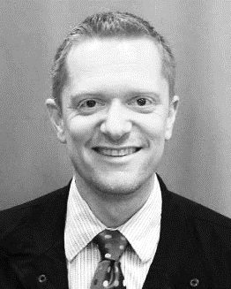
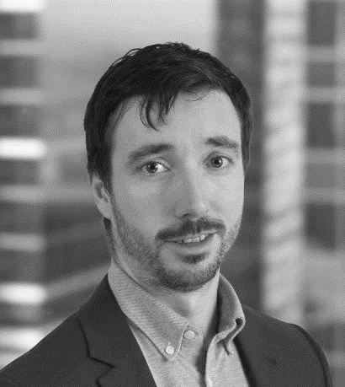
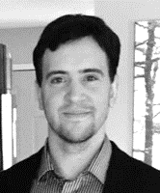
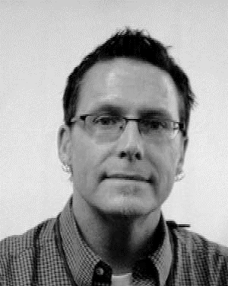
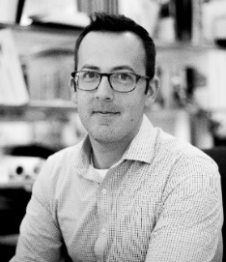
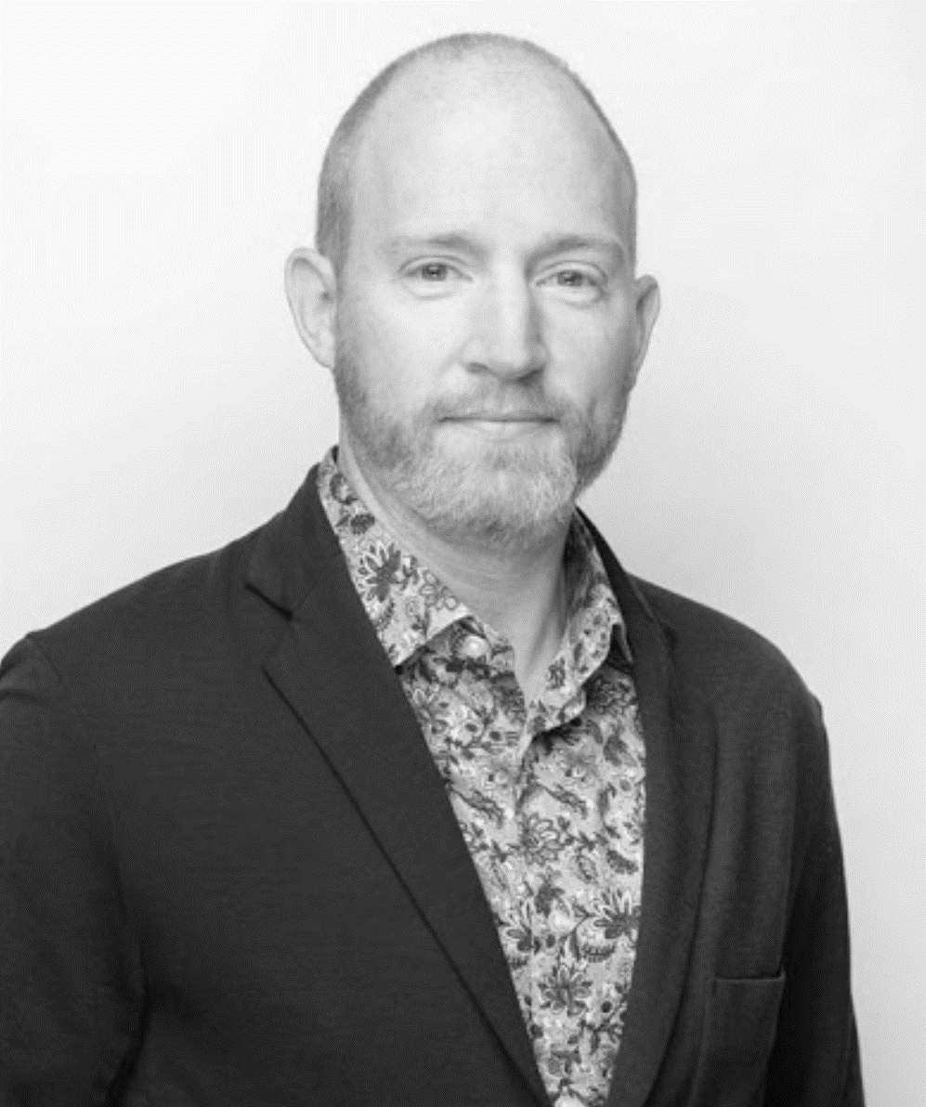
Committee Membership
Committee Membership
Som Bose
Mark Cammisuli
Kevin Shea
Kevin Shelast
Cam Ewart
Kevin Humeniuk
Tyler Holmberg
Architect, S&T Regional Leader Architecture49
P.Eng, Industrial Sales Manager Preston Phipps
P.Eng, Principal AME Group Consulting Mechanical Engineers
P.Eng, Territory Manager Aqua Air Systems Ltd.
Associate Director, O&M VIDO-InterVac
Architect, Principal S&T National Sector Leader Architecture49
Senior Product Specialist Scientific and Institutional Spaces Solutions Buildings Interiors
http://slcan.ca/about-us/professional-development-committee/

Slide 30
Committee Purpose
Purpose:
The PDC will be responsible for the professional development and the fundraising/sponsorship for Sustainable Labs Canada.
The Committee will provide advice to the Board with respect to developing resources for the members of SLCan. These resources can be but are not limited to webinars, white papers, databases and reference information to existing sustainable information relevant to sustainable laboratories.
The Committee will also look to develop professional linkages and partnerships with other for-profit and not-for-profit organizations that have a direct interest in sustainability. These linkages and partnerships are to be explored for funding opportunities through joint initiatives or direct sponsorship with SLCan.
Requirements / Mandate:
The PDC will be responsible for creating a directory of ‘sustainable resources’.
The PDC will be responsible for identifying and coordinating webinars and additional educational opportunities.
The PDC will be responsible for identifying and establishing partners in sustainability.

Slide 31
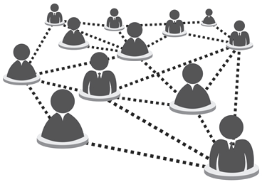
Key PDC Mandates and Membership Benefits
Webinar Access (including past Webinars)
Reference Documents
SLCan Community Networking Connections
Conference and Workshop Reduced Registration Fees

Slide 32
Committee Activities
Regular committee meetings - monthly
Past Conference Presentations
Past Webinars
Reference Documents
SLCan Blog
Frequently Asked Questions
Forums
Glossary of Terms
LinkedIn – Sustainable Labs Canada https://www.linkedin.com/groups?home=&gid=4280555
Facebook Page https://www.facebook.com/SustainableLabsCanada/
Online Training Resource List
Online Reference Documents
Library

Slide 33
Committee Look Ahead
Call for Abstracts for 2021 Webinar Series is currently open. 2021 Webinar Series roster will be published in the coming week.
Support to the 2021 Conference Committee as required.
Collaboration on the development of Canadian Benchmarking Tool based on Canadian Labs and Climate Ranges
Further development of online resources, including Library and Online Training Links.
Further development of Social Media and Blog.

Slide 34
SLCan Chapter Updates
Montreal
Two events in 2020:
February 26th: « Les bonnes approches dans la planification des nouveaux laboratoires », held in person. Speaker : Mr. Javier Arguedas, Waldner International.
October 7th: » Certifications Living Building Challenge, Well et Passivhaus appliquées à la conception de laboratoires au Canada », held online. Speaker : Mr. Philippe St-Jean, McGill University.
Toronto

Slide 35
2021 Plans and Priorities
Planning and execution of 2021 Conference
Proposed location is Vancouver – details coming soon!

Slide 36
Other
Business

Slide 37
Adjournment

